Slide 1





Phases of Project Management Processes
There are five phases in project management processes lifecycle. These processes are Initiation, Planning , Execution, Monitoring and Controlling and Project Closing
Initiation
Planning
Execution
Monitoring and Controlling
Project Closing

Slide 2


INITIATION
First phase of the project development lifecycle that determines the overall success of the project
The project’s suitability and significance are assessed based on its purpose, feasibility, objectives and high-level scope
We create an argument for why the project is necessary, its benefits, costs, ROI(return on investment) and the alternative solution considered for stakeholders
After approval from relevant stakeholders, we identify the key team members along with the project manager and other employees

Slide 3


PLANNING It includes a detailed step-by-step plan to complete the project from initiation to closing. It includes:
Defining project scope, goals, and objectives.
Creating timelines, finalizing budgets, and allocating resources.
Identifying potential project risks and methods to eliminate those risks.
Establish clear communication with everyone involved in the project.
Setting quality criteria.

Slide 4


EXECUTION
Initiation​
Begin assigned tasks according to the project plan.​
Assign responsibilities and ensure resource availability.​
Monitor task progress and maintain open communication.
Monitoring Progress​
Track performance against established benchmarks.​
Identify and address any deviations or issues promptly.​
Monitor budget and resource allocation.​
Provide regular progress reports to stakeholders.​

Slide 5


MONITORING & CONTROLLING
Scope Tracking
Cost Tracking
Schedule Tracking
Issue Tracking
Progress Reporting

Slide 6

PROJECT CLOSING
Actions taken to complete all tasks across all PMPGs in order
Formally meet the requirements of the project, phase, or contract
Provides an essential benefit by assisting in the prevention of unpleasant and detrimental instances
Must conduct project closing at each and every phase gate

Slide 7

What is a project management methodology?
It is a framework that helps us to manage project
Why do we use it?
To ensure optimum performance.
How do we use it? By applying different type of methodologies ; Among these , waterfall and agile is highly preferred

Slide 8
Agile VS Waterfall
Requirements
Design
Coding
Test
Deploy
Requirements
Design
Coding
Testing
Deployment

Slide 9
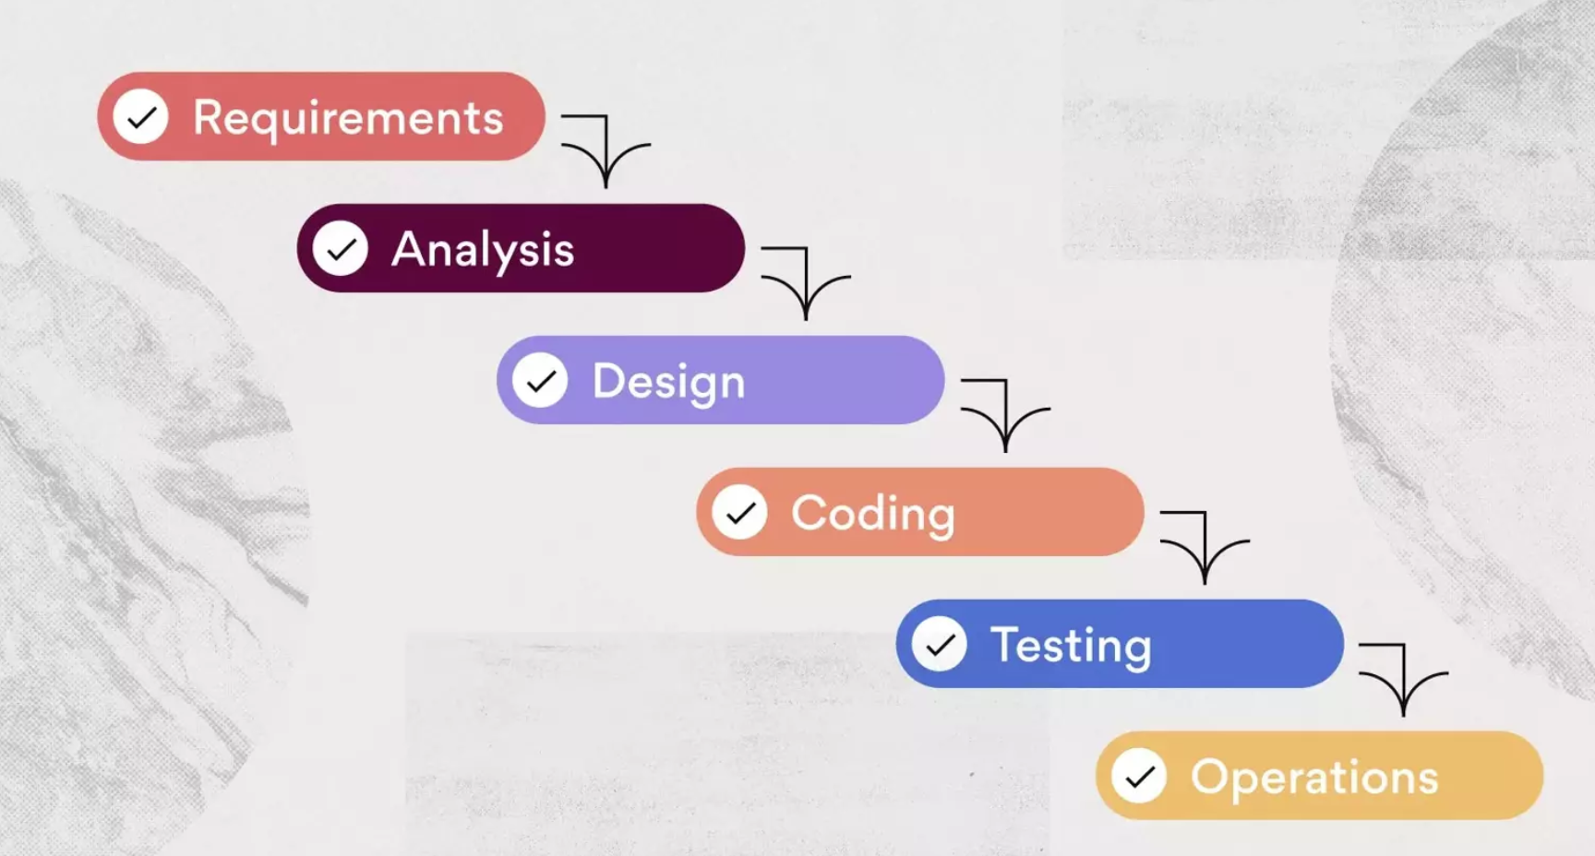
Waterfall
Step-by-step progression
Each step must be completed before moving to the next; no going back to previous stages
Not flexible
Provides a clear project timeline
Industry / Example : Construction

Slide 10
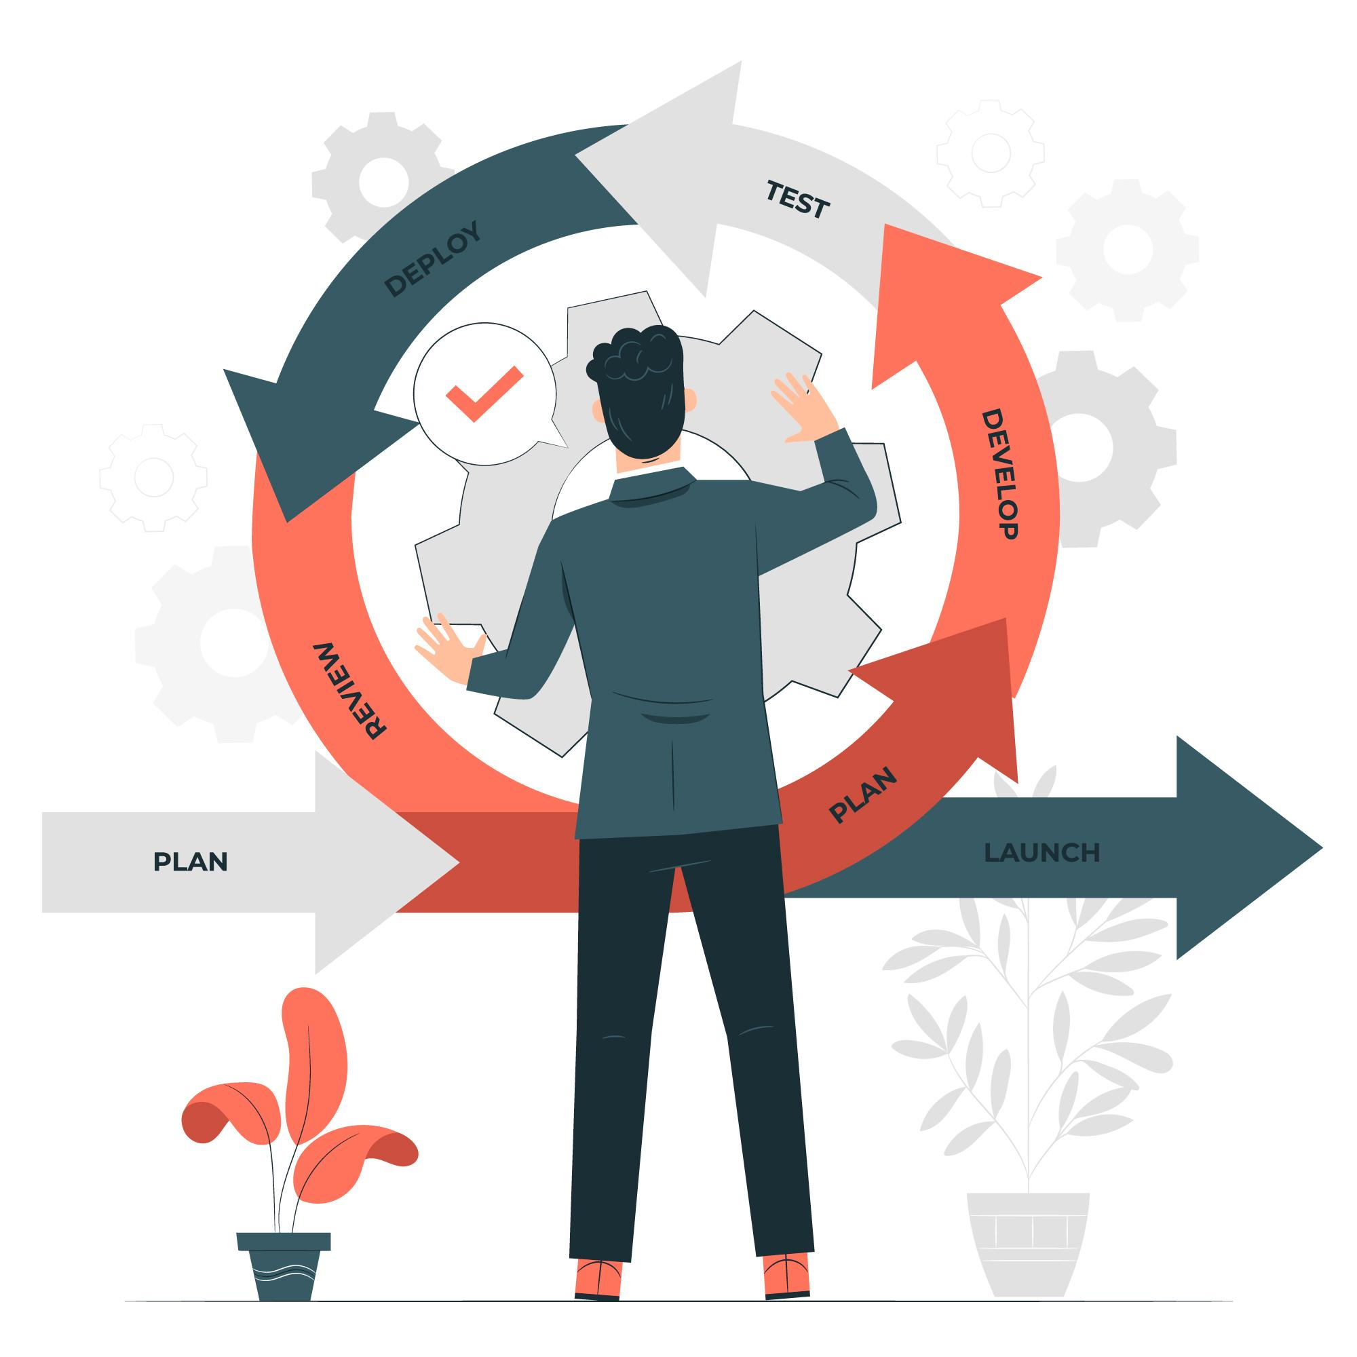
Agile
Iterative process
Teams collaborate closely
Continuous customer feedback
Flexible; allows for changing requirements
Drawback: can make it challenging to predict project timelines and costs accurately
Industry / Example: IT industries use SCRUM

